Slide 1
Tensys Internal Training
Derivation of Material Stiffness Properties
July 2018

Slide 2
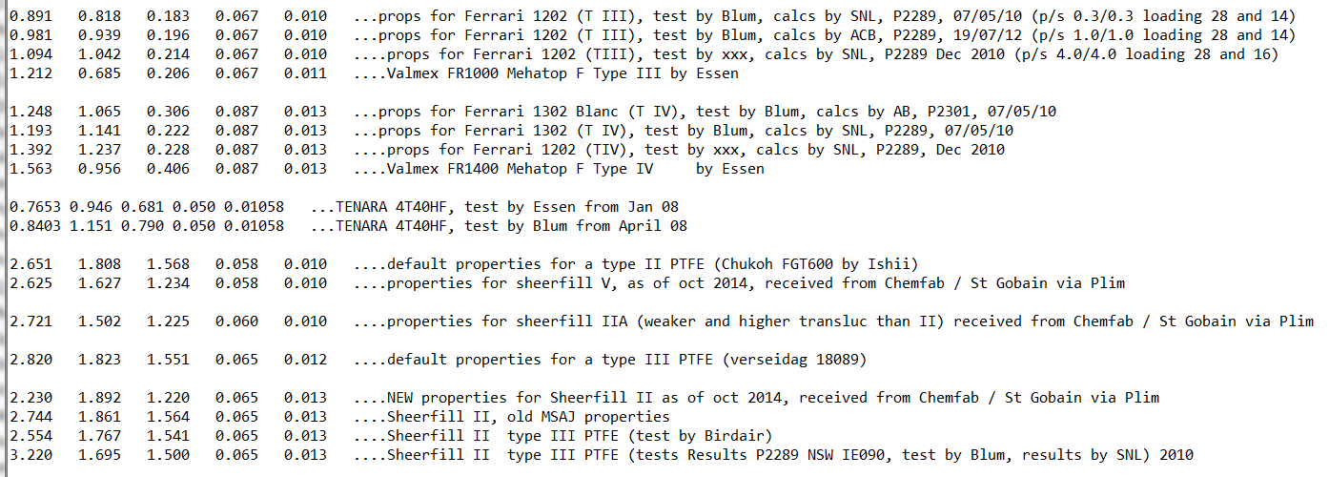
Introduction
Stiffness properties for woven materials, NOT films (ETFE, balloons)
EA_{w} , EA_{f} , EA_{wf} as below, for internal use only.
Use E_{w} , E_{f} , n_{w} , n_{f} when reporting to the outside world

Slide 3
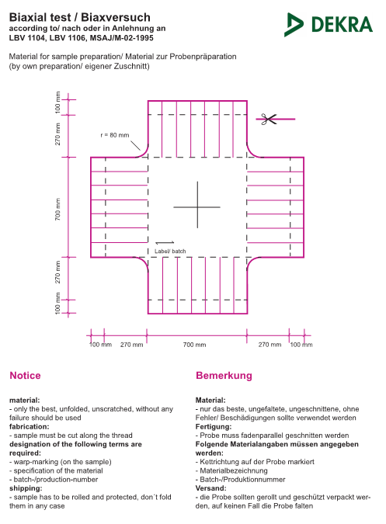
Introduction
Properties determined by biaxial test
Doesn’t have to be fabrication batch
Specialist testing houses
Dekra, Stuttgart
Universirty of Essen
Newcastle University
Other
Typical sample size is 500 to 700mm²
MSAJ loading protocol and approach

Slide 4
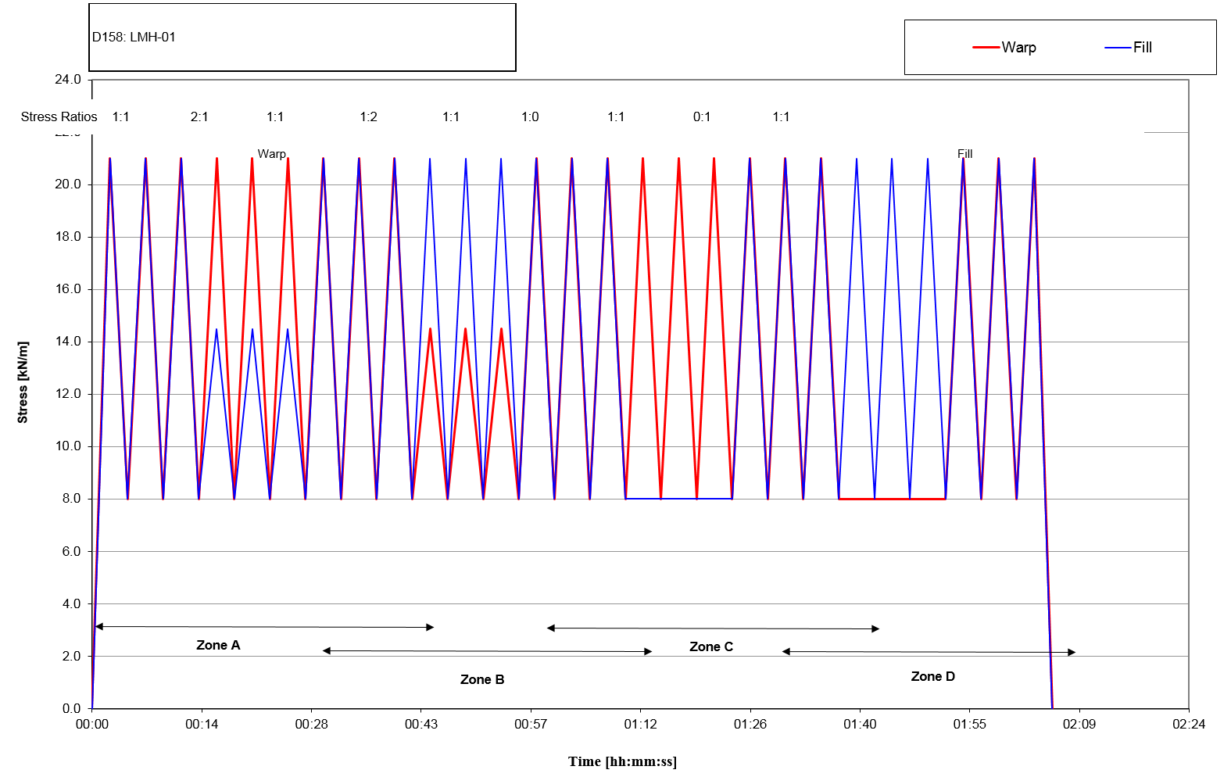
MSAJ Protocol
Typical loading rate is 2 to 4 mm per minute, e.g. 0.007% per second!
Pre-stress to suit material / Maximum force ~1/4 of tensile strength
Distinct loading regimes, 1:1, 2:1, 1:2, 1:0, 0:1 (5 in total)

Slide 5
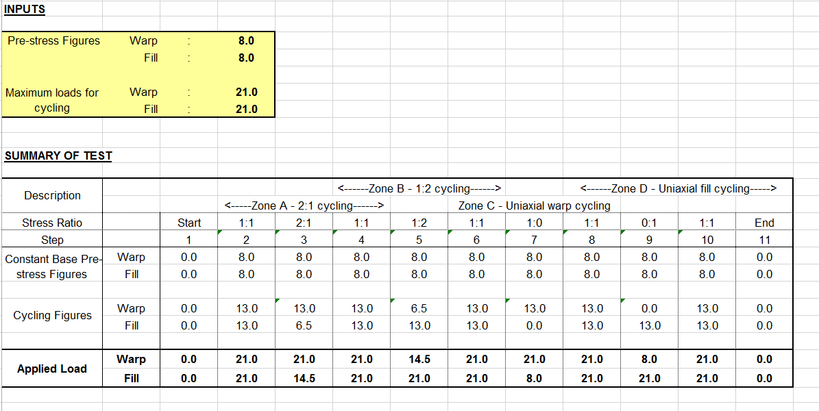
MSAJ Protocol
Standard sheet to plot this out Dekra
Note that loading is relative to pre-stress

Slide 6
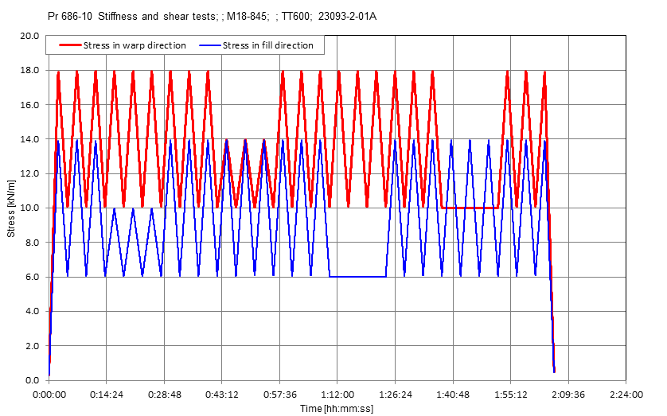
MSAJ Protocol
Alternative loading – tailored towards specific project

Slide 7
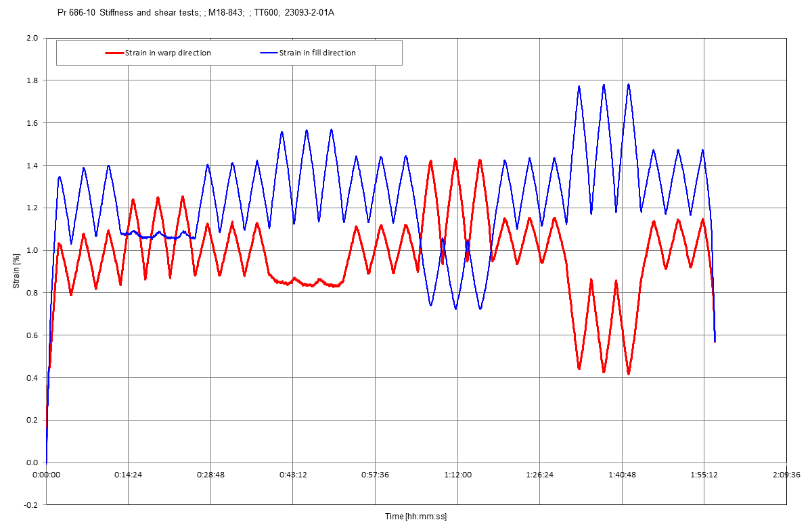
Results
Request raw data excel from testing house, copy into ‘standard sheet’
Typical results – Strain v time

Slide 8
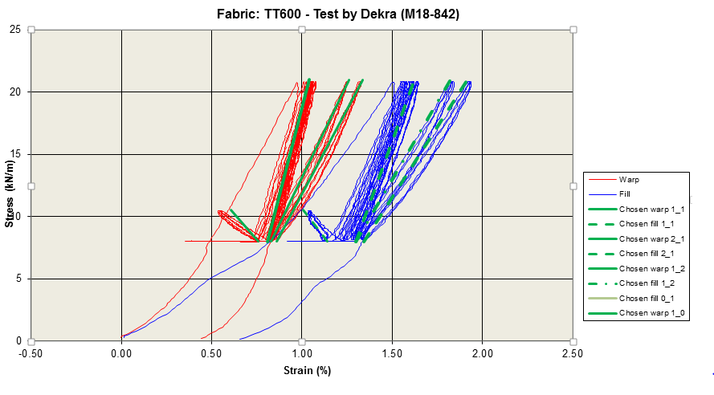
Results
Typical results – stress v strain
Aim is to define some ‘representative’ properties

Slide 9
Interrogation
Standard sheet for processing of test data
Copy raw test data into standard sheet
Hmmm.
ED
NICK
ADAM
SEAN

Slide 10
Interrogation
Aiming to get moduli which match the different parts of the graph
Pick one of the load up curves from each zone

Slide 11
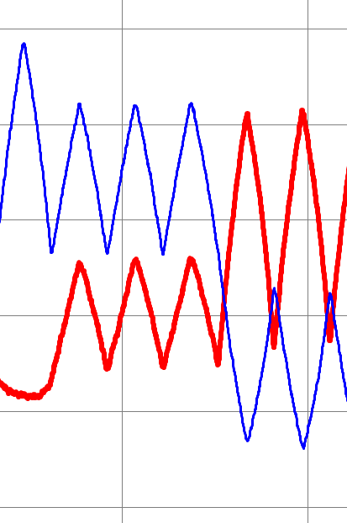
Interrogation
For one load up identify
Start warp stress / strain
End Warp stress / Strain
Ditto Fill
Note may be –ve strain
How?
Interrogate raw tabulated data?
Hover over graph in excel
Data entered into processing s/s

Slide 12
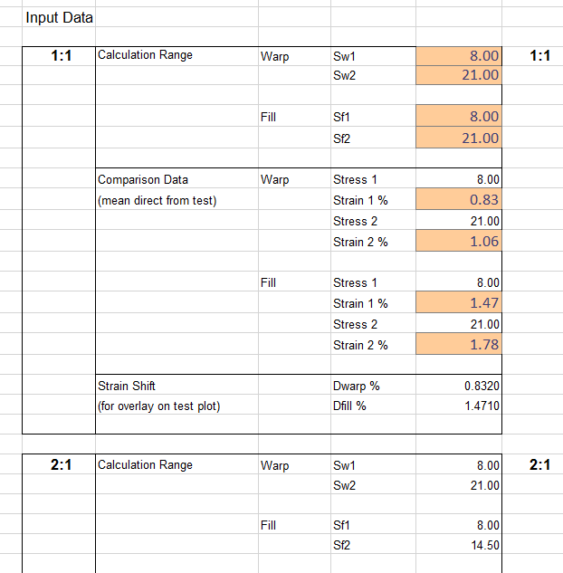
Interrogation
For one load up identify
Start warp stress / strain
End Warp stress / Strain
Ditto Fill
Note may be –ve strain
How?
Interrogate raw tabulated data?
Hover over graph in excel
Data entered into processing s/s

Slide 13
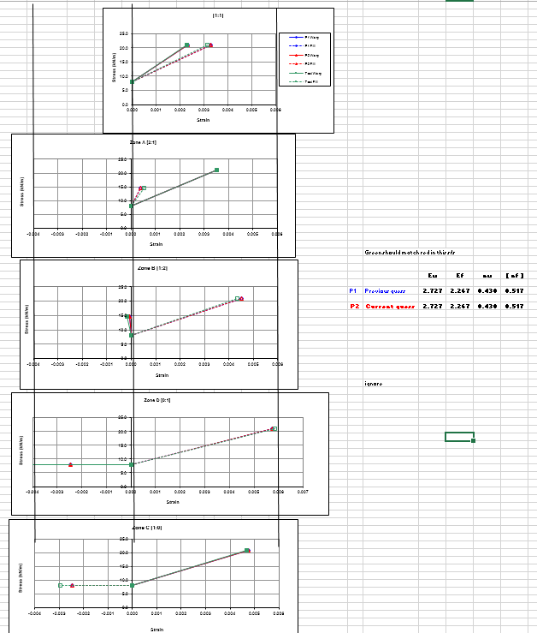
Interrogation
Master adjustment tab
Graphical trial and error approach to determine set of representative figures
Overlay of test results in green with stress v strain response calculated from

Slide 14
Interrogation
Tips
Ensure graphs have similar strain scales
If you cant match them all then bias towards expected loading regime
1:0 F(E_{w} , E_{f}) only
1:2, 2:1 etc F (E_{w} and n)
Have a play!

Slide 15
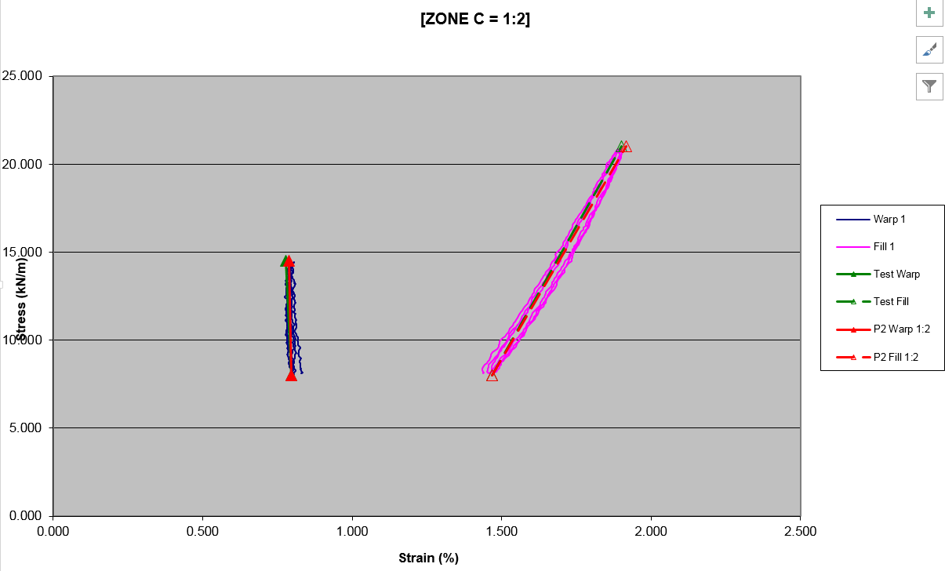
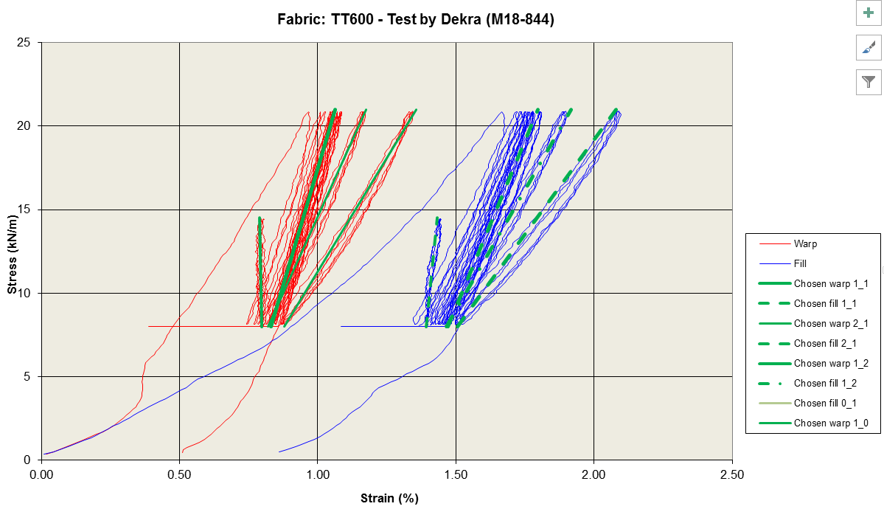
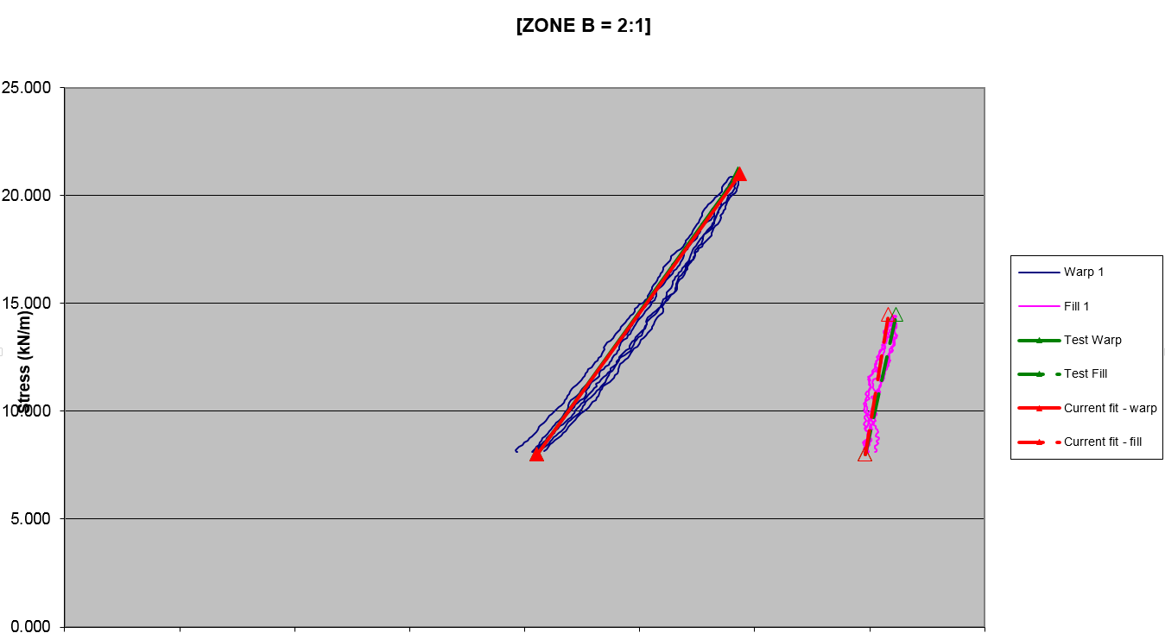
Interrogation
Final cross check on stress v strain
Both full and zones
Checking both calculated properties AND choice of ‘test’ data against actual test data

Slide 16
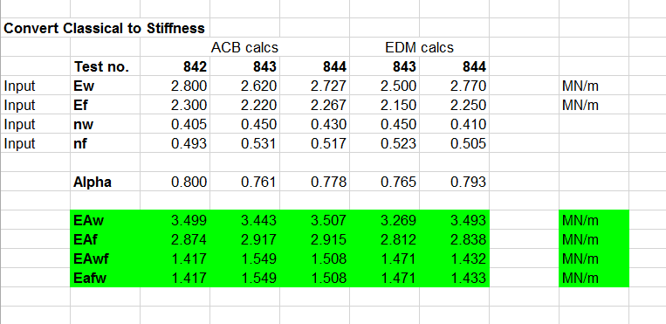
Interrogation
Collate results from different tests
Convert to EA format for inTENS

Slide 17
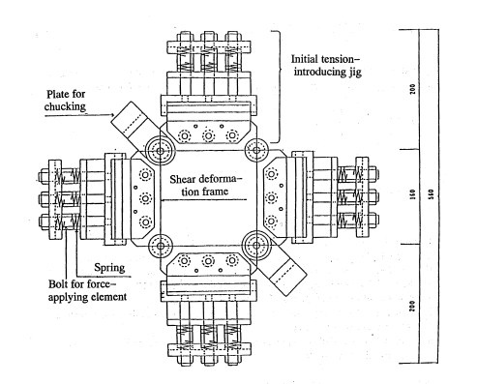
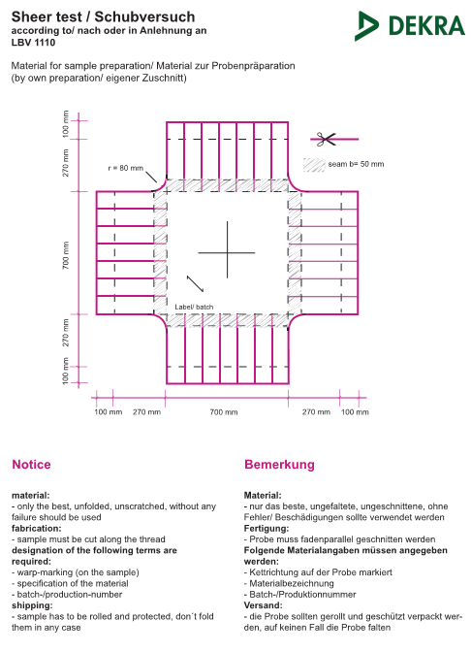
Shear stiffness
Shear modulus
Testing undertaken by
Kawabata, Yokohama University
Small sample, pre-tensioned and sheared
Dekra
Sample at 45 degrees + axial pull
OR sample at 90 degrees and ‘shear’ pull
University of Newcastle
?
University of Essen
?

Slide 18
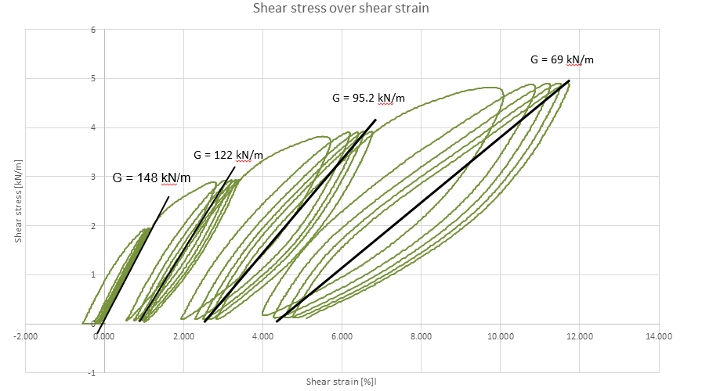
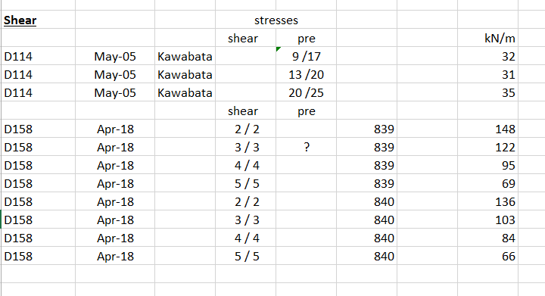
Shear stiffness
Results vary depending on
Sample pre-stress
Shear load applied
Further investigation required
Default value is Ew/10

